Slide 1

November
Mon
M | T | W | R | F | A | U
1 | 2 | 3 | 4 | 5 | 6 | 7
8 | 9 | 10 | 11 | 12 | 13 | 14
15 | 16 | 17 | 18 | 19 | 20 | 21
22 | 23 | 24 | 25 | 26 | 27 | 28
29 | 30
Next Week
Tues
Wed
Thurs
Fri

Slide 2

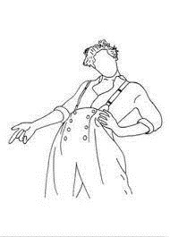
Sat
Sun
Notes

Slide 3

November 2021
Utilities
38
75
113
150
Groceries
75
150
225
300
Dining Out
75
150
225
300
Commute
23
45
68
90
Cat Stuff
10
20
30
40
Beauty
10
20
30
40
Entertainment
38
113
150
75
113
75
Savings
125
250
375
500

Slide 4

November 2021
Income
Itemized List
Total:
Expenses
Rent
Phone
Streaming
Nosaeron
Utilities
Groceries
Dining Out
Commute
Cat Stuff
Beauty
Entertainment
Savings
Other

Slide 5
Meal Prep & Log
Breakfast
Lunch
Dinner
M
T
W
R
F
A
U

